Slide 1
Selling Your Case to a Prosecutor Cindy Harper Division Chief
Notes:
Experience Levels:
What are the most difficult things about your job as a prosecutor so far?
Taking what’s on paper – or electronic report these days – and figuring out what happened and how that will play out in the courtroom
Lake County – S.O., FHP, Game and Fish and 13 municipal police departments
How many make filing decisions/or are they made for you
Filing Decision is most important decision
True or not true
Why
First building block – foundation, your building wonky from the beginning if don’t get it right
We are going to look at the guidelines provided in Rules of Criminal Procedure, bar rules, etc

Slide 2
ROLE OF THE PROSECUTOR
Prosecutors represent the people of their jurisdiction and have a duty to seek justice in every case, carefully evaluating the evidence presented and protecting the rights of the accused.
They represent the government in criminal cases and are responsible for ensuring that justice is served by prosecuting individuals accused of committing crimes.
Throughout the criminal justice process, the prosecutor works with law enforcement agencies to investigate crimes, determine whether charges should be filed, and prosecute cases in court.

Slide 3
ABA Criminal Justice Standard
Standard 3-4.3 Minimum Requirements for Filing and Maintaining Criminal Charges
(a) A prosecutor should seek or file criminal charges only if the prosecutor reasonably believes that the charges are supported by probable cause, that admissible evidence will be sufficient to support conviction beyond a reasonable doubt, and that the decision to charge is in the interests of justice.

Slide 4
SAO5 PROSECUTORIAL POLICY
The sole objective of a prosecutor is to seek justice. Few functions of government carry consequences as far-reaching as the decision to initiate and prosecute a criminal charge. The decision to charge should be made only after thorough investigation of all the available evidence, and after a decision has been reached that the available and legally admissible evidence provides for a substantial likelihood of conviction at trial. Charges should not be filed which are greater in number or degree than can reasonably be supported by the evidence at trial and prosecutors shall not engage in charge bargaining.

Slide 5
WHAT HAPPENS AFTER AN ARREST
Filing decision
Discovery
Resolution

Slide 6
FILING DECISION

Slide 7
FILING CONSIDERATIONS
There must be a substantial likelihood of conviction at trial. Among the factors to consider in this regard are:
The seriousness of the crime.
Whether or not there are witnesses to the crime.
The credibility and independence, or lack thereof, of the witnesses to the crime.
Whether or not there is corroborating physical, video, or recorded evidence.
Statements of the defendant and witnesses to the crime.
Strength of admissible evidence.
The criminal history of the defendant.
Whether or not the interests of justice warrant prosecution of the case.
Whether the conviction will be affirmed on appeal.

Slide 8
FILING CONSIDERATIONS
While a prosecutor must retain his/her independence and make decisions based first upon the law and the facts, the wishes of those affected by the decision to file or not must be considered.
While the desires and input of victims and law enforcement should be considered in all cases, the ultimate decision rests with the Assistant State Attorney and should be based upon a through consideration of all available evidence in a given case, legal authority, and factors articulated within this policy. A case that cannot be proven, or that does not constitute a violation of the law, should not be filed simply to please affected individuals.

Slide 9
INVESTIGATION
“Probable cause” versus “Beyond a reasonable doubt”
Probable cause sufficient to justify an arrest exists where the facts and circumstances, as analyzed from the officer's knowledge, special training, practical experience, and reasonably trustworthy information, are sufficient in themselves for a reasonable person to reach the conclusion that an offense has been committed.
A reasonable doubt is not a mere possible doubt, a speculative, imaginary or forced doubt. Such a doubt must not influence you to return a verdict of not guilty if you have an abiding conviction of guilt. On the other hand, if, after carefully considering, comparing and weighing all the evidence, there is not an abiding conviction of guilt, or, if, having a conviction, it is one which is not stable but one which wavers and vacillates, then the charge is not proved beyond every reasonable doubt and you must find the defendant not guilty because the doubt is reasonable.

Slide 10
INVESTIGATION
Witnesses:
Get statements
Recorded
Written
Ask questions
Identifying information
Contact information (!!)

Slide 11
INVESTIGATION
The scene and evidence:
Photograph or film
Collect & package evidence
Finger prints
DNA
Contamination
Chain of Custody(!!)

Slide 12
INVESTIGATION
Follow up investigation:
Additional witnesses?
Jail calls?
Search warrants?
Subpoenas?

Slide 13
PRESENTING THE CASE
Probable cause affidavit
Incident report
Written statements
Recorded interviews
Photos
Videos
When in doubt, talk it out!

Slide 14
DISCOVERY

Slide 15
DEPOSITIONS
STATE’S DISCOVERY EXHIBIT
Category A: Yes, without leave of court;
Category B: Yes, with leave of court upon good cause;
Category C: No
Unlisted witnesses: Yes, without leave of court

Slide 16
DEPOSITIONS
CATEGORY A
eye witnesses,
alibi witnesses and rebuttal to alibi witnesses,
witnesses who were present when a recorded or unrecorded statement was taken from or made by a defendant or codefendant, which shall be separately identified within this category,
investigating officers,
witnesses known by the prosecutor to have any material information that tends to negate the guilt of the defendant as to any offense charged,
child hearsay witnesses,
expert witnesses who have not provided a written report and a curriculum vitae or who are going to testify, and
informant witnesses

Slide 17
DEPOSITIONS
Purpose: To discover what evidence may be available for use at trial.
Scope: Any matter;
Not privileged;
Relevant to the subject matter of the pending action (claims or defenses)
Including the existence, description, nature, custody, and location of books, documents, or other tangible things; or he identity and location of persons having knowledge of discoverable matters;
OR, information reasonably calculated to lead to the discovery of admissible evidence;
Use: Impeachment

Slide 18
IMPEACHMENT
Prior inconsistent statements → Get it right in your PC, reports, and at depo
Bias → “Just the facts.”
Character for untruthfulness
Prior convictions for certain crimes
Defect in capacity to observe, remember, and recount matters → Prepare!
Introduction of other facts contradictory

Slide 19
REMINDERS
Make sure you understand the question.
Answer only the question asked of you.
Beware of compound questions.
Do not volunteer information; it is the attorney’s job to elicit it.
Tell them if you are estimating (height, weight, distance, time, speed, etc.)

Slide 20
RESOLUTION

Slide 21
PREPARATION FOR TRIAL
Review your report
Review video and other recordings
Review your deposition
Ask prosecutor what else to review. Interviews? Surveillance? Etc.?
Confirm the location and date/time to arrive

Slide 22
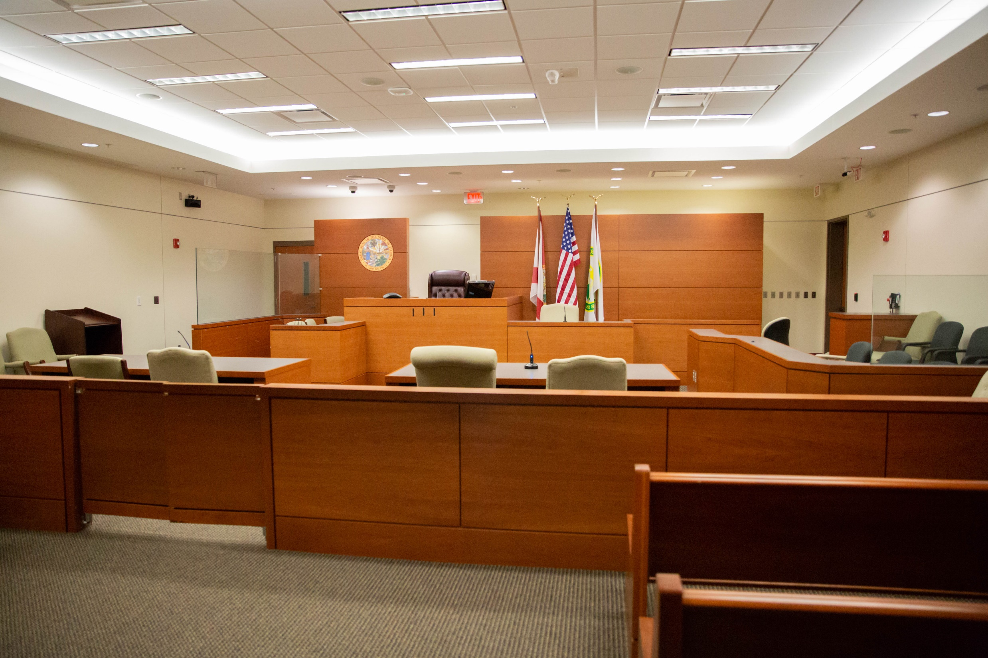
Clerk - Judge - YOU
Defense – State - Jury

Slide 23
TESTIFYING
Direct examination
“Introduce yourself to the jury.”
Don’t use legalese – use everyday, conversational language.
Direct your answer to the jury.
Make eye contact with the jury.
Speak up so the jurors can hear you.
Cross-examination
Re-direct examination

Slide 24
RULES OF TESTIFYING
Sit up straight
Don’t chew gum
Talk to the jury
Tell the story
On cross-examination,
Be brief
Concede what you cannot deny
Stand firm
Remain polite and don’t argue
Listen to the question
Don’t be afraid to ask for clarification
Answer the question asked

Slide 25
AFTER TRIAL
Ask prosecutor to call you when the verdict comes in
Ask how you did as a witness
Ask how you can improve
Ask to be notified about sentencing

Slide 26
QUESTIONS?
CHARPER@SAO5.ORG
(352)671-5800

