Slide 1
Procurement for Inspectors/Evaluators
Presented by:
Tony Montero
Palm Beach County OIG
Contract Oversight & Evaluations Division

Slide 2
Course Objectives
Describe how Inspectors/Evaluators provide oversight into the procurement process.
Understand the risks and opportunities for fraud, waste, and abuse in the procurement process.
Recognize the opportunities from a contract oversight function on the OIG’s mission and activities

Slide 3
Inspectors & Evaluators
Why is Procurement and Contracts Oversight Unique?

Slide 4
Unique Oversight
We’re Live!
The procurement activities monitored are usually live or in-process.
This differs from investigations, audits, and other oversight activities that are typically conducted after-the-fact.

Slide 5
Unique Oversight
We may be able to help and not fault!
The Inspector/Evaluator may be able to provide instructional information before the entity compounds an improper action or error.
For example, in Florida, two common municipal bidding errors are not complying with the Consultants Competitive Negotiations Act (CCNA) when obtaining Architect & Engineering Services, and not complying with the Florida Statutes 218.39 when obtaining outside audit services.
In these situations, the Inspector/Evaluator can remind the entity of the statutory requirements, or reference the OIG’s Tips and Trends publications prior to an award decision so that timely corrective action can be taken.

Slide 6
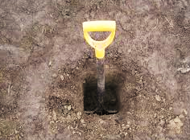
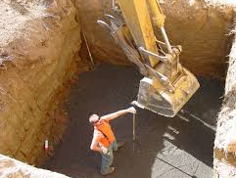
Unique Oversight
It’s not a Deep Dive!
Inspectors and Evaluators need to cover a lot of ground in reviewing the procurement process.
A review/evaluation must be flexible, responsive, and balanced in both depth and scope.
Audits & Investigations
Inspections/Evaluations

Slide 7
Unique Oversight
Thinking on our feet!
Conducting a review in the procurement process means constantly analyzing the situation and determining the next course of action.
When reviewing documents, observing meetings, or scrutinizing a process, the Inspector/Evaluator needs to analyze the facts and determine if further action is warranted.
If further action is warranted, then the Inspector/ Evaluator needs to determine how best to proceed.
This is a very fluid and dynamic environment!

Slide 8
Unique Oversight
Presence!
The act of observing tends to influence the phenomenon being observed.
The Inspector/Evaluator’s continuous presence and oversight in the procurement process:
The process is typically executed more dutifully when the
participants know it is being observed.
Helps develop a rapport with public employees, and vendors.
Creates pathways of trust and understanding.
Provides insight into emerging trends and issues.
Is a form of outreach which is noticeable to the public!

Slide 9
Procurement Fraud
The role of the Inspector/Evaluator is to:
Find…. In all of this….
Waste of public funds & resources
Administrative errors & code violations
Kickbacks/Bribes
Conflicts of interest
Fraudulent companies/orders/invoices
Bid collusion/Bid rigging
Delivery fraud
Labor/materials mischarges
False statements/claims
and more…

Slide 10
Finding Proof

Slide 11
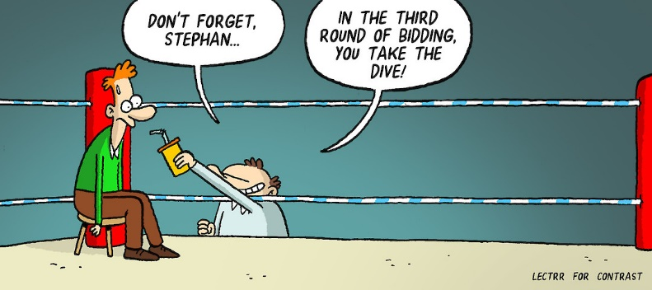
Finding Proof

Slide 12
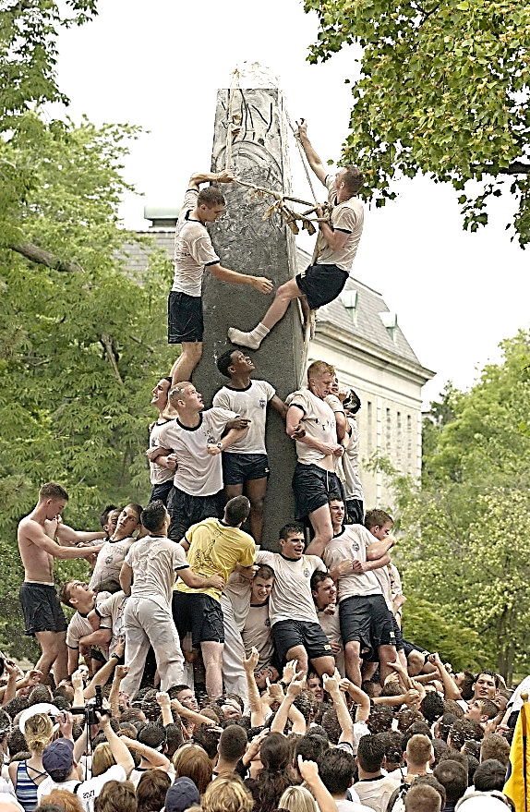
Joint Reports & Activities
Contract Oversight functions can also be cooperative, with the work shared between different IG divisions, such as Investigations, Intake, and Audit.
Joint activities provide:
An effective use of personnel and resources to accomplish an activity or project.
Develops positive office working relationships.
Improves report focus on the key issues and better manages next step actions.
Timely accomplishment of the report/conclusion of activities.
Increased analysis of risks and red flags for follow-on audit and investigative activities.

Slide 13
Procurement Process
The 3 main parts of the procurement process are:
PRE-AWARD AWARD POST-
AWARD
Funding
Prepare Bid
Solicit
Evaluate
Award
Admin.
Close Out
Each part of the procurement process is unique; the objectives, scope, and methodologies used in procurement oversight will vary with each function. Advanced planning and continuous monitoring are necessary and important to Inspectors/Evaluators when conducting reviews.

Slide 14
Case Study: Lifeguard Towers
The Complaint
IG Intake received a citizen’s complaint that a City’s award of a Request For Proposal (RFP) was:
Improper and unfair because there was only one bidder
The City did not confirm the vendor’s qualifications
The specifications limited competition
The vendor qualifications were too restrictive
The price was higher than other public purchases of similar items.

Slide 15
Case Study: Lifeguard Towers
Intake
Intake developed the complaint further by working with the citizen to define their concerns, their desired outcomes, and obtain documentation relevant to the complaint from the citizen.
Intake concluded that:
The citizen was alleging misconduct by public officials.
The complaint issues were very complicated and would require an in-depth look.
Researching the complaint would require expert knowledge in municipal proceedings, contracts and solicitations, and technical specifications.

Slide 16
Case Study: Lifeguard Towers
Investigations
Since the complaint alleged misconduct by public officials, Investigations took the lead in reviewing the complaint documentation.
Investigations’ review determined that:
The allegations of misconduct were declaratory statements only, not supported by any fact, document, or information in the complaint.
The documentation did not readily reveal any improprieties executed by City staff in violation of their duties.
The substance of the complaint concerned possible violations of Purchasing policies, City procedures, and industry/business practices.

Slide 17
Case Study: Lifeguard Towers
Contract Oversight
While Investigations used it’s resources to perform checks on the award vendor, and for any conflict of interest or ethics violations with City staff, Contract Oversight took lead in researching the remaining policy and procedural issues.
Contract Oversight performed extensive research on:
The City’s Purchasing code and policies regarding solicitations. In particular: bid specifications, bid evaluation procedures, vendor responsibility determinations, proposal responsiveness, and single bids.
Other municipal bids for Lifeguard Towers comparing specifications and prices with the City’s contract.
Industry standards, business practices, construction codes and fabrication techniques, and an elemental cost analysis.

Slide 18
Case Study: Lifeguard Towers
Challenges
While working to expedite a response to the citizen’s complaint, there were a number of impromptu challenges:
By the time the complaint was received, the award had already been approved by City Council after a long and spirited public debate.
The citizen continuously updated the complaint with mostly repeated, but occasionally new, allegations and documentation. (Shotgun approach)
The citizen was experienced with complaints, and widely distributed the complaint updates to public officials and the media, which prompted at least 4 different news reports.
A City Council Member contacted the IG and expressed support of the citizen’s complaint.
A municipal election was being held 2 months after the IG received the complaint, and the award for the Lifeguard Towers was a political talking point.

Slide 19
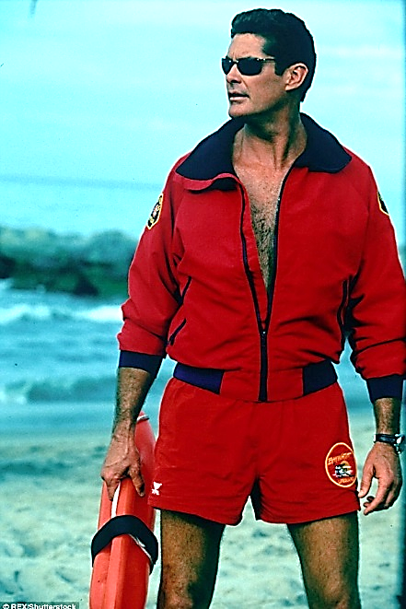
Case Study: Lifeguard Towers
Results
The review of the RFP and award process found:
The public entity’s bid specifications and vendor qualifications were justified and not unduly restrictive.
The City followed its policies and procedures for the award to the sole bidder.
The price was fair, reasonable, and within the market range.

Slide 20
Case Study: Lifeguard Towers
What were the benefits from the joint activity?
The total complaint processing time, from receipt to report, was only 2.5 months.
Each division was able to focus on the subject areas inherent to their abilities.
The utilization of personnel skilled in construction, engineering, purchasing, fraud detection, and cost analysis yielded a comprehensive review of the issues.

Slide 21
Case Study: The Short List
Evaluation Committees and Meetings
It’s important to observe evaluation committee meetings.
Record the facts, but understand the dynamics between the members and the vendors!
Watch–Listen-Learn!
The character and conduct of the solicitation process can
indicate a problem with the:
Bid document
Specifications
Vendors
or matters internal to the public entity

Slide 22
Case Study: The Short List
Things to consider:
Are any of the discussion comments:
Inappropriate
An attempt to influence through a superior-subordinate relationship
A committee member eager to persuade other members
Is a voting committee member not prepared, inattentive, or absent?
Was the scoring, and final vendor selection equitable to the committee discussions?
Were the proper evaluation procedures followed?
Beware of CCNA shortcuts by the Selection Committee…
Typical Arguments: Streamlined, hybrid, cost savings, & no need for discussions.

Slide 23
Case Study: The Short List
Engineering Short List Committee
A whistleblower complaint alleged that an Engineering Supervisor (ES), while serving as the Chair of the Engineering Short List Committee:
Improperly voted for firms with whom they maintained close personal relationships with the principal consultants and/or owners.
Improperly influenced the votes of subordinate Committee members.
The entity’s policy, and Committee practices are not in compliance with the Consultants Competitive Negotiation Act (CCNA).

Slide 24
Case Study: The Short List
The results of the interviews were:
ES acknowledged the close personal relationships with the identified owners.
ES had regular weekly lunches with 3 firm owner’s for at least 20 years.
ES’ entire extended family spent Christmas Eve at one owner’s home for over 10 years, while the owner and his wife spent Christmas morning opening gifts at ES’ home.
ES took a joint family vacation with one owner every year up until 10 years ago. The company owner always paid for the lodging.

Slide 25
Case Study: The Short List
Interview (cont):
ES denied showing any favoritism.
None of the Committee members interviewed stated that ES directly influenced their choices either before, during, or after Committee meetings.
But, half of all the Committee members interviewed felt that ES indirectly influenced or attempted to influence either their future choices or other Committee members' future choices.

Slide 26
Case Study: The Short List
Conclusion:
Two of the three allegations were deemed to be inconclusive.
One allegation was not supported.
The OIG uncovered significant issues for which corrective actions must be taken.
Epilogue:
To better understand this report, some discussion of Inspector General standards and the gray area between legality and what is right is warranted.
OIG investigations are usually initiated as a result of allegations that someone acted in violation of an established standard, such as a law, ordinance, or policy.

Slide 27
Case Study: The Short List
Epilogue:
The IG gathers and evaluates facts/evidence and then examines the applicable standards to determine whether or not the alleged actions violated those standards. Both a preponderance (or majority) of evidence, and a violation of a specific law, ordinance, or policy is required to support/substantiate the allegation of wrong doing.
In this case, two of the three allegations were deemed to be inconclusive due to a lack of established standards.
However, just because certain actions may not be Illegal does not make those actions right. When situations like this come to light, corrective measures must be taken. Such actions may include the establishment of new policies or procedures and appropriate personnel actions.

Slide 28
Case Study: The Short List
Highlights:
Over 3 years, ES served as the Committee Chair on 25 bids. On 18 bids, proposals were received from ES’ “friends”. 17 times ES voted to advance the “friends” company.
Committee interview comments about ES:
A vindictive person, power hungry, intimidating, holds a grudge, throws fits, and continually reminds subordinates that they are employed “at-will.”
Negative comments against “friends” means the employee is personally “against” ES.
Often has terse words with members after meetings about their choices.
Asked the IG for a warning before report was released to “prepare for blowback.”
Notes:
Give Tonya McConnell example

Slide 29
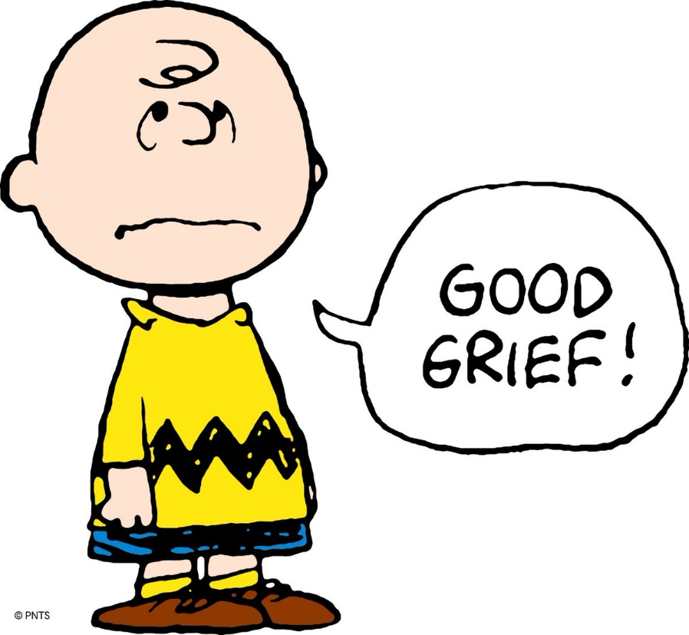
Case Study: The Short List
ES’ Classic Quote:
“everybody does their [own] vote… and I am entitled to vote however I see fit...and if it's for my friends,
hallelujah."

Slide 30
Case Study: Awards
Evaluation of bids/offers, and final vendor selection for award
Data analytics can reveal a Committee Member who scores high, low, fair, tough, inconsistent, or unfair when compared to the rest of the Committee.
Ordinal scores, or ranking, can be used to verify the integrity of the numerical scoring.
Identifies any other scoring patterns, anomalies, or inconsistencies.
Locates scoring anomalies so severe that they alter the rank or scores.
May indicate collusion between a member and the vendor; a member trying to fix the results to favor a particular vendor.
Vendors often look for arbitrary and capricious scores, or scores that are not based in full fact and faith in order to protest the results of Committees.
Data is meaningless unless its interpreted in the proper context using common sense!

Slide 31
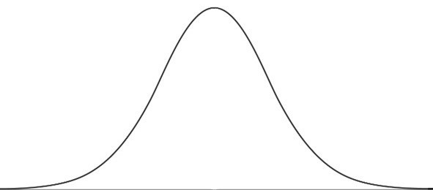
Case Study: Data Analysis Example
Do the proposals meet cost and service expectations?
Vendor D
SERVICE
Vendor A
Vendor C
Vendor B
COST

Slide 32
Case Study: Awards
Vendor Oversight
Oversight is a review that is more in-depth than a simple determination of vendor responsibility.
Inspectors and evaluators should consider:
Who owns the company?
Are there any ethical conflicts by individuals?
Are there any ethical conflicts with the company?
Is there history between the company, the entity, and any of their employees?
Is the vendor the incumbent?

Slide 33
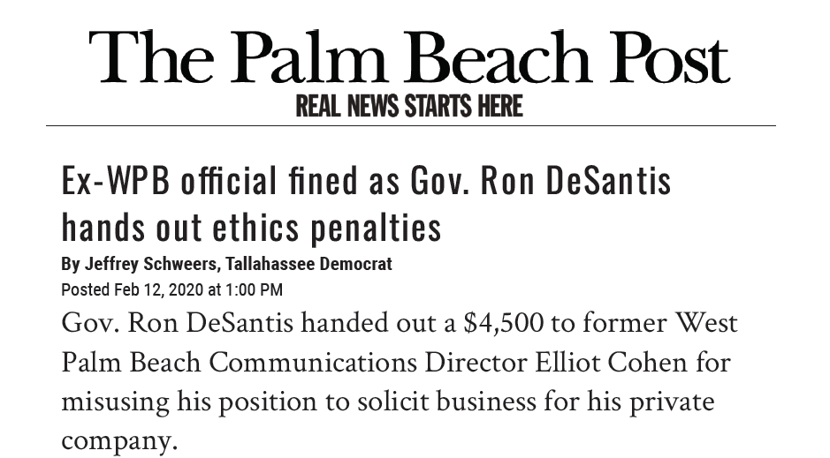
Case Study: Awards

Slide 34
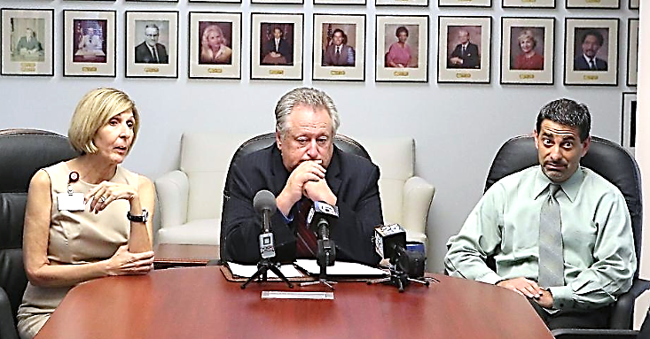
Case Study: Awards
The Palm Beach Post (cont’d)
Cohen remained under contract with RMA (bidder) without telling the mayor, city administrator or city ethics officer. Also troubling, the Office of Inspector General found "a spike of communication” between Cohen and RMA’s chief executive during the bidding, while Cohen had access to confidential information that could have helped the company.
The three alleged violations — misuse of his public office, soliciting business for his firm and having a contract with the bidder — could have led to penalties ranging from public censure, reprimand or a civil penalty of up to $10,000 per violation.

Slide 35
Case Study: Electrical Repairs
Investigative Report 2019-0007: Electrical Repair Services
Whistleblower complaint alleging that an electrical repair contractor for the County since 2003, submitted invoices that falsely represented the source and price of materials purchased under the contract.
The contractor did not provide the contractually required original manufacturer/supplier cost documentation to the County with invoices for service calls.
Contractor submitted invoices from a supplier that did not actually supply or manufacture those materials, was owned and operated by the same principals as the Contractor, and was used solely to mark-up prices. Those mark-ups averaged 107.2%.
Contractor failed to provide the County with any cost documentation for over $750,000 in materials costs.

Slide 36
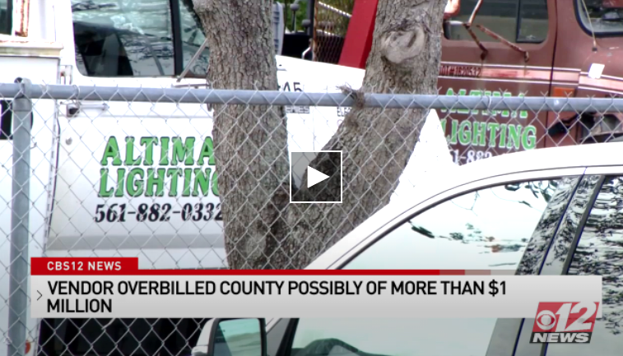
Case Study: Electrical Repairs
Investigative Report 2019-0007: Electrical Repair Services
Identified Costs: $ 180,210
Questioned Costs: $1,860,194
Estimated Overbilling:
Over $1,000,000
This matter was referred to
law enforcement.

Slide 37
Case Study: Electrical Repairs
What were the red flags?
County paid for parts at cost and required the original supplier invoice as back up. 65% of contractor invoices did not have required backup.
Contractor did not retain contract records as required by law.
Invoices that were submitted with supplier invoice mostly lacked any specificity and descriptions to match the invoice to manufacturer part numbers and prices. But, some part numbers were a close or partial match to manufacturer numbers.
Supplier had the same business address as contractor.
The President of the supplier was the VP of the Contractor. The VP of the supplier was an employee of the contractor.
Supplier had no other customers beyond the Contractor.

Slide 38
Case Study: HVAC Repairs
At the same time, we received another whistleblower complaint about an HVAC contractor?
Contractor created shell company that falsely claimed to be an “OEM manufacturer/supplier”.
Invoices washed through “shell” company at an inflated rate. Owned by same principals as HVAC contractor.
Business address for suppliers was a storage unit.
Was not an OEM supplier and had no commercial business or banking activity.
Only verified $70K in overbilling due to a lack of proper invoice documentation.
Questioned costs in excess of $1M due to a lack of proper documentation over the life of the 5-year contract.

Slide 39
Benefits of Inspectors/Evaluators
We’re always looking for red flags
Invoices missing important information like part numbers and descriptions, and lack supporting documentation.
Intentionally using odd or confusing part names, numbers, and abbreviations to obscure matter.
Amateurish invoices: fonts mismatch, no logo, inconsistent spacing, lack of embellishments like a website or social media.
Substitution of items for cheaper, but similar looking materials.
Altered insurance certificates and invalid bonds.
Unlicensed company or use of a fraudulent contractor’s license.
E-Verify questions led to insurance fraud investigation. Contractor arrested.
Same vendors repeatedly winning solicitations.
Repeated emergency and sole source orders.
“It just doesn’t feel right.”

Slide 40
Questions &
Comments?

