Slide 1

Targeted Violence Prevention Team

Slide 2
Targeted Violence Prevention
A collaborative, integrated systems approach to ensure that no identified person of concern who poses a threat of targeted violence is left unmanaged.

Slide 3
Targeted Violence Prevention
The operational nature of targeted violence makes it amenable to prevention effort through intelligence gathering, proactive investigation, behavioral analysis, and strategic intervention.
Persons of concern for targeted violence typically do not snap; they decide.

Slide 4
Targeted Violence Prevention
They decide that interpersonal violence is a necessary, justified, or an acceptable solution to a grievance or overwhelming combination of life stressors.
When a person of concern is unable to cope, and maintain a sense of cognitive, emotional, and social instability, targeted violence may result.
These variables lead a person of concern down a identifiable pathway to targeted violence

Slide 5
Targeted Violence Prevention
The Pathway to Violence:
A series of sequential steps before a violent act.
It originates as a felt grievance, moves to a violent ideation, to research & planning, to preparation for violence, to breaches of security or other boundaries, to a concluding attack and often suicide.

Slide 6
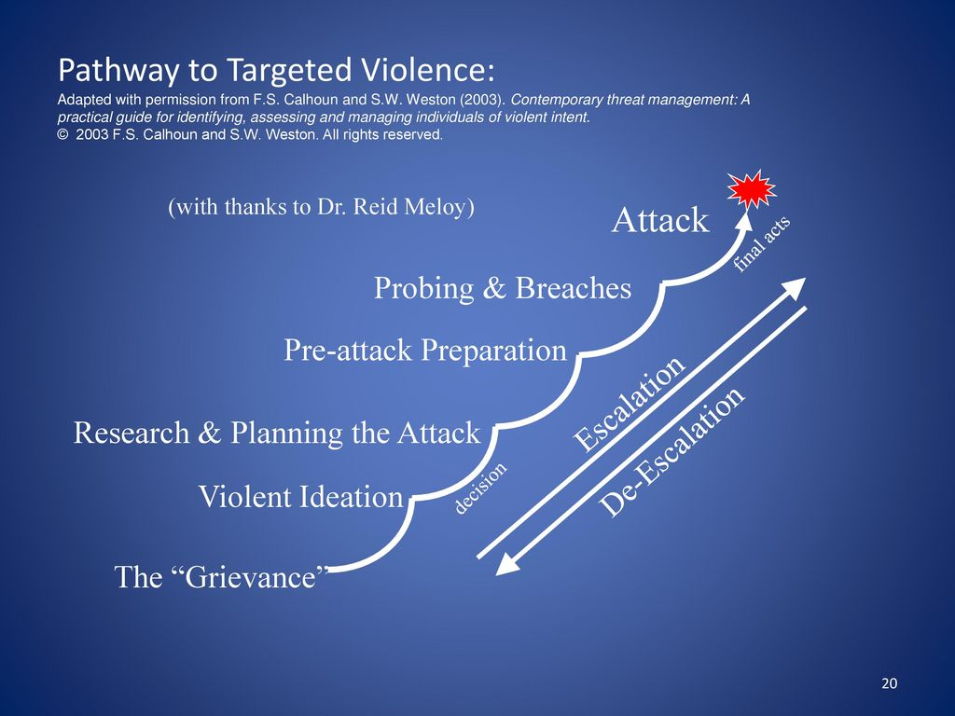
Targeted Violence Prevention

Slide 7
Targeted Violence Prevention
Behavioral Threat Assessment & Management (BTAM)
Operationally defined, BTAM is a specific application of intelligence-led policing, based on a structured, iterative, and interactive process that may be implemented as a formal program, when properly resourced.
BTAM relies heavily on an integrated systems approach driven by collaborative, multi-disciplinary, and multi-jurisdictional partnerships focused on intervention and prevention.

Slide 8
Targeted Violence Prevention
Initial Triage by looking at key behavioral indicators
Has a history of violent behavior
Has undergone a recent life event or stressor
Has expressed a desire for revenge or recognition
Has a history of mental health concerns and/or Baker Act
Has articulated by word or mouth a recent threat of violence
Has an ideation of violence, suicide or a mass casualty event
Has a recent and uncharacteristic move of money or belongings
Has a violent focus against a specific group or category of people
Has a recent acquisition of weaponry and/or bulk ammunition
Is associated with or a member of a security threat group (STG)
Has a recent acquisition of bomb making materials & procedures (BMAP)
Has an unwarranted focus on critical infrastructure or public soft target
Is a prior subject of a LE, DOE or other official threat assessment process
Has obsessive behavior to engage, communicate, or make actual contact with a person of infatuation

Slide 9
Targeted Violence Prevention
360 Degree Analysis
We Focus on the Subjects Ideas & Actions
Motives – Grievance / Ideology
Target – Chosen person or Group
Planning – Leakage
Articulated Threat – By Word or Mouth
Symptoms of Mental Illness – Dr. or Counselors
Significant Life Experiences – 3rd party intel

Slide 10
Targeted Violence Prevention
Assessment Involves:

Slide 11
Targeted Violence Prevention
Identify the grievance:
1. Anger - surrounding an injustice and/or combined with moral outrage – (anger is a secondary emotion)
2. Shame - Embarrassment
3. Blame - Target is identified and Blamed (projection)
4. Loss in Love or Life - What loss is at stake in love or life (work)
Grievance + Low Self Esteem + Revenge or a Seeking for Recognition are more likely to engage in violence.

Slide 12
Targeted Violence Prevention
Assessment Involves identifying where the person my be within 3 Behavioral Stages
Motivation
Preparation
Mobilization

Slide 13
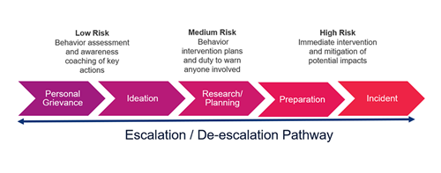
Targeted Violence Prevention
Assessing Risk

Slide 14
Targeted Violence Prevention
The Menninger Triad
3 Violent Wishes
1. Wish to Die – Suicidal Ideation
2. Wish to Kill – Homicidal Ideation
3. Wish to be Killed
These three wishes indicate virtual certainty of violence.
-Dr. Karl Menninger

Slide 15
Targeted Violence Prevention
We must maintain a duty to protect our community.
Management of the person does not focus solely on arrest and prosecution as the best intervention strategy available in situations where a person of concern poses a threat of targeted violence.
However, in targeted violence cases where a threat persists on the pathway without abatement, arrest and prosecution may indeed be the only or best strategy available to ultimately prevent an attack.

Slide 16
Targeted Violence Prevention
7 Management Solutions/Interventions
1. Address the grievance
2. Change the mindset or counter the narrative
3. On the radar of LE or line of sight “notice”
4. TPI - Third Party Interventions; Trip wires & “See Say”
5. Target Hardening & Removal of Opportunity (RPO’s)
6. Baker Act
7. Arrest

Slide 17
Targeted Violence Prevention
Questions?
SAS Jason Knowles
Cell 850-251-1706
Office 850-410-8853
JasonKnowles@fdle.state.fl.us

